Slide 1

$µ$-CON Workshop’18
“ Wireless Game Controller
Using Infrared Data Transmission ”

Slide 2
Session 3: Timers and Interrupts
29th Sep’18, 14:00 to 17:00 Hrs.

Slide 3
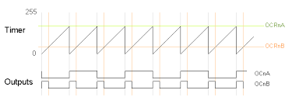
TIMERS AND PWM

Slide 4
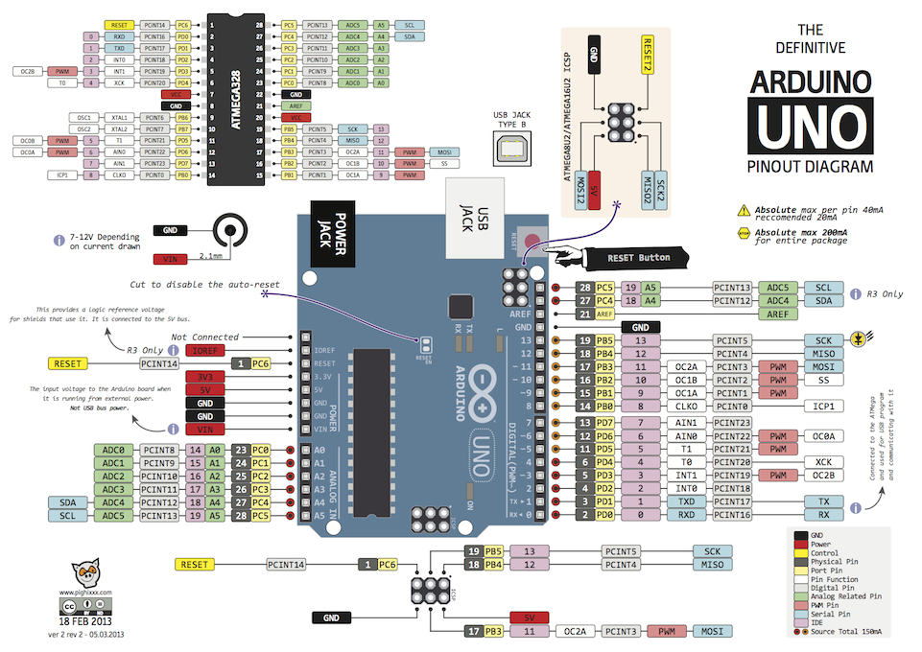

Slide 5
Clock in an MCU
The clock in the MCU is generated on the principle of piezoelectricity using piezoelectric crystals.
Microcontrollers need clocks so that our programs can be executed in rhythm with
the clock.
A basic instruction is processed when a tick from the clock passes.
The timer and counter functions in the microcontroller simply count in sync with the microcontroller clock.

Slide 6
Timers:
Counts in binary at a regular interval provided by a clock
and updates an 8 bit or 16 bit register.
A 16 bit timer implies that it counts from 0 to 2^16-1 i.e 0 to
65535 ….or in hexadecimal form---0x0000 to 0xFFFF
A timer has other register which specifies the counting mode,
the pace and about the functions of timer.
Arduino UNO has three timers:
TIMER0 8 bit
TIMER1 16 bit
TIMER2 8 bit

Slide 7
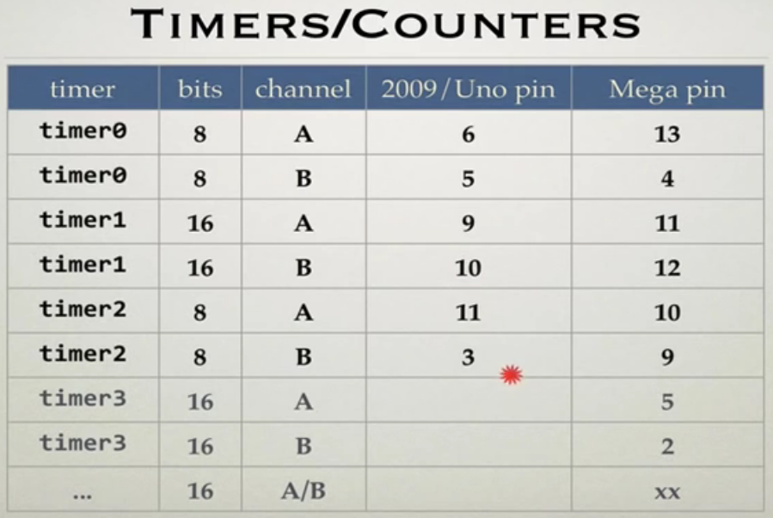
Timers:

Slide 8

Prescaler:
The timer and counter functions in the microcontroller simply count in sync with the microcontroller clock.
Prescaling is simply a way for the counter to skip a certain number of microcontroller clock ticks.
The AVR microcontrollers allow prescaling (skipping) numbers of: 8, 64, 256 and 1024.

Slide 9
Existing Timer Use:
millis() and micros() function uses timer0.
The analogwrite() function
_delay_ms() function
Servo library (uses Timer 1)

Slide 10

Timer Modes:
Normal
CTC – Clear Timer on Compare Match
Fast PWM
Phase Correct PWM

Slide 11
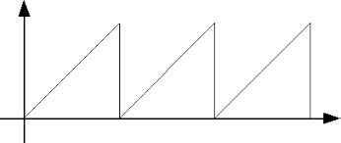
Normal Mode:
OxFF
O
TOVn
TOVn
TOVn
Counts till 0xFFFF
TOVn flag is set when overflow occurs

Slide 12
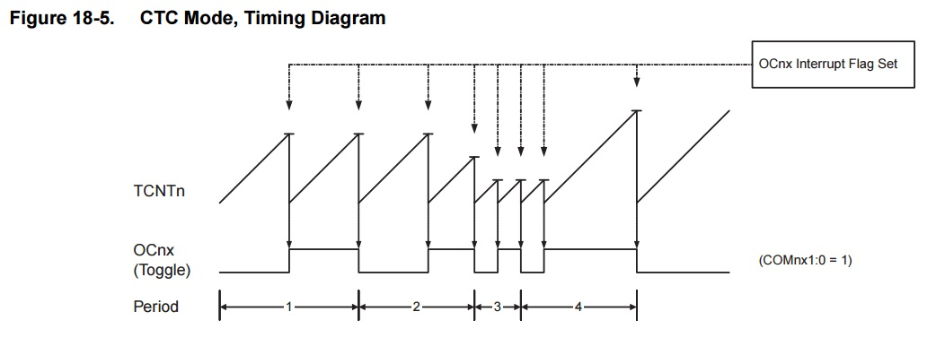
CTC Mode:
Timer is rolled back to “0” when it reaches OCRnA value
Only TIME PERIOD can be varied and not DUTY CYCLE

Slide 13
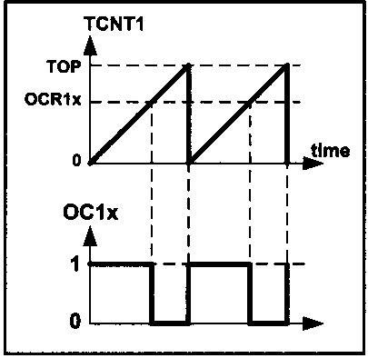
Fast PWM Mode:
Duty Cycle can be varied
The width of the pulse/frequency can
be varied using OCR1

Slide 14
Basic Registers of TIMERS:
TCCRnA/TCCRnB – Timer/Counter Control Register
TCNTn – Timer/Counter Register
TIFRn – Timer/Counter Interrupt Flag Register
OCRnA/OCRnB – Output Compare Register
TIMSKn – Timer/Counter Interrupt Mas Register
n - counter/timer number 0,1,2

Slide 15
TIMER0:
It is a 8 bit timer.
TCCR0A/TCCR0B – Timer/Counter Control Register 0 A/B
TCNT0 – Timer/Counter Register 0
TIFR0 – Timer/Counter Interrupt Flag Register 0
OCR0A/OCR0B – Output Compare Register 0 A/B
TIMSK0 – Timer Interrupt Mask Register 0.

Slide 16
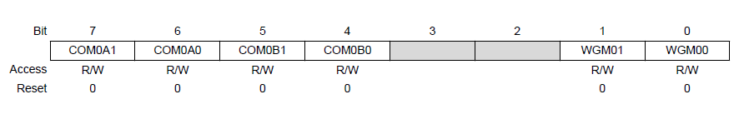
TCCR0A:
8 Bit Register used for control of Timer0.
Bits 7:6 – COM0An: Compare Output Mode for Channel A [n = 1:0]
Controls the behaviour of output control pin OC0A
Bits 5:4 – COM0Bn: Compare Output Mode for Channel B [n = 1:0]
Controls the behaviour of output control pin OC0B
Bits 1:0 – WGM0n: Waveform Generation Mode [n = 1:0]
These bits combined with WGM02 in TCCR0B sets the mode in which timer operates

Slide 17
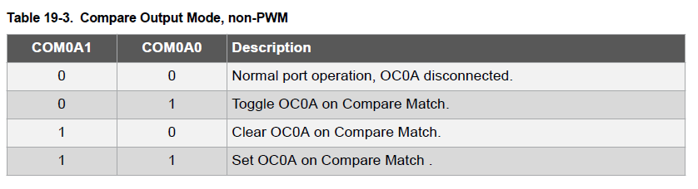
TCCR0A(Contd..):

Slide 18
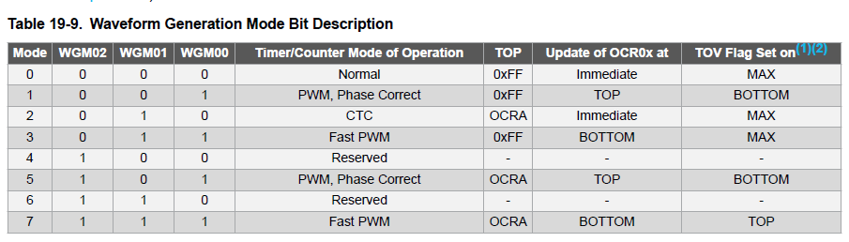
TCCR0A(Contd..):

Slide 19
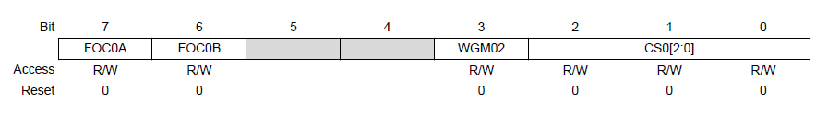
TCCR0B:
Bit 7 – FOC0A: Force Output Compare A
Force output compare for channel A under non-PWM modes.
Bit 6 – FOC0B: Force Output Compare B
Force output compare for channel B under non-PWM modes.
Bit 5 – WGM02:
Used to set waveform generation mode.
Bit 2-0 – CS0[2:0]:
The three Clock Select bits select the clock source to be used by the Timer/Counter. Indirectly they are used for prescaling.

Slide 20
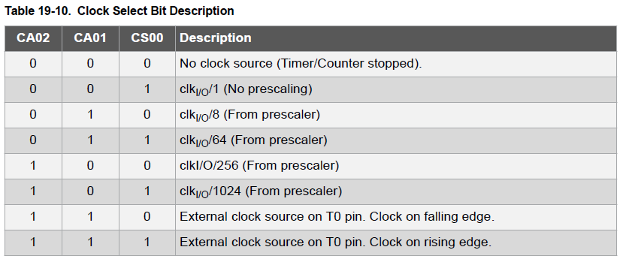
TCCR0B(Contd..):

Slide 21
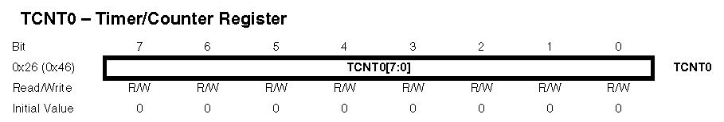
TCNT0:
The register that holds the count is called the TCNT register. It is a 8 bit version.

Slide 22
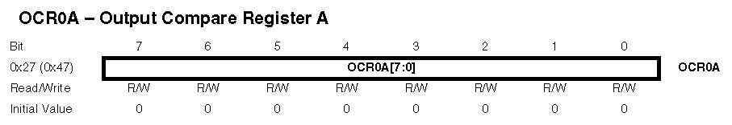
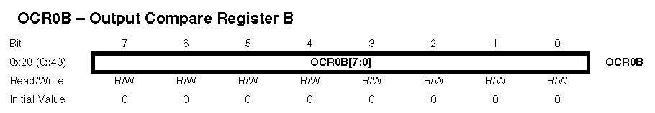
OCR0[A/B]:
8 Bit Register used in Clear Timer on Compare Match Mode.

Slide 23
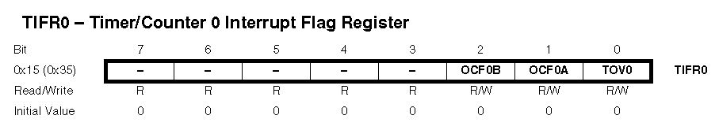
TIFR0:
TIFR0 Register contains flags of Timer 0.
Bit 2 – OCF0B: Timer/Counter0, Output Compare B Match Flag
The OCF0B bit is set when a Compare Match occurs between the Timer/Counter and the data in OCR0B
Bit 1 – OCF0A: Timer/Counter0, Output Compare A Match Flag
The OCF0A bit is set when a Compare Match occurs between the Timer/Counter and the data in OCR0A.
Bit 0 – TOV0: Timer/Counter0, Overflow Flag
The TOV0 bit is set when overflow occurs in TCNT0.

Slide 24
TOV0:
Timer0 Overflow Flag is set to 1 when the counter overflows, going from 0xFF to 0x00 and it remains set until the software clears it.
In order to clear it, we need to write 1 to it and 0 to the other bits.
For example, TIFR0|= 0b 00000001 clears TOV0 flag.

Slide 25
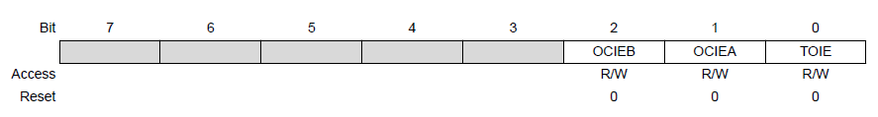
TIMSK0:
Bit 2 – OCIEB: Timer/Counter0, Output Compare B Match Interrupt Enable
When this bit is written 1, and OCF0B goes to 1, the corresponding Interrupt Service routine is fired.
(If global interrupt is enabled). When routine overs OCF0B is cleared automatically.
Bit 1 – OCIEA: Timer/Counter0, Output Compare A Match Interrupt Enable
Bit 0 – TOIE: Timer/Counter0, Overflow Interrupt Enable
We will learn more about interrupts at the end of this session

Slide 26
Lets Calculate:
Set the prescaller.
Calculate the time taken for each tick.
Suppose frequency is f MHz. (after prescaling)
Then Time Period will be 1/f, which is time taken for each tick.
Now look for the time required.
Divide the time required by the time for one tick gives you the number of ticks required.

Slide 27
Example Code:
Q. Initialise Timer 0 at Normal mode, no prescaling.
ANS:
TCCR0A = 0x00;
TCCR0B = (1<<CS00);
TCNT0 = 0;
Q. Initialise Timer 0 at CTC Mode, no prescaling in such a way that max time it can count is 15.625us.
ANS:
OCR0A = 250;
TCCR0A = (1<<WGM01)|(1<<WGM00);
TCCR0B = (1<<CS00);
TCNT0 = 0;

Slide 28
Let’s CODE!! LED TOGGLING USING TIMER 0
Q. Use TIMER 0 to toggle a LED at the maximum possible rate .

Slide 29
Coding:
#include<avr/io.h>
int main()
{
DDRB = 0xFF;
PORTB=0x00;
Serial.begin(9600);
TCCR0A = 0x00;
TCCR0B= (1<<CS02)|(1<<CS00);
while(1)
{
if(TCNT0>=255) {
PORTB^=0xFF;
Serial.println(“Toggle”); }
}
return 0;
}
Blinking is too fast ???
What can we do ?

Slide 30
Coding:
#include<avr/io.h>
int main()
{
DDRB = 0xFF;
PORTB=0x00;
Serial.begin(9600);
TCCR0A = 0x00;
TCCR0B= (1<<CS02)|(1<<CS00);
long int k=0;
while(1)
{
if(TCNT0>=255)
++k;
if(k>=200) {
PORTB^=0xFF;
k=0;
}
}
return 0;
}

Slide 31
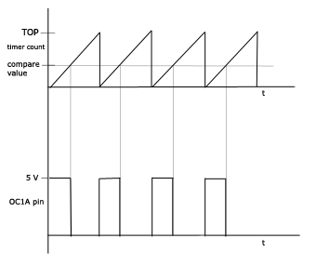
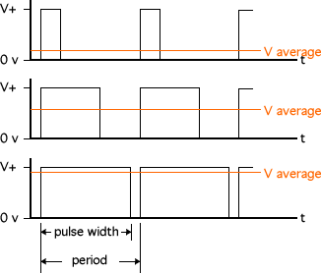
Pulse Width Modulation(PWM):
Pulse Width Modulation, or PWM, is a technique for getting analog results with digital means. Digital control is used to create a square wave, a signal switched between on and off.
Need for PWM
Duty Cycle

Slide 32
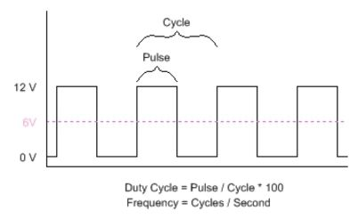
Duty Cycle:
Commonly used for driving motors, heaters, LEDs or lights in varying intensities or speeds.

Slide 33
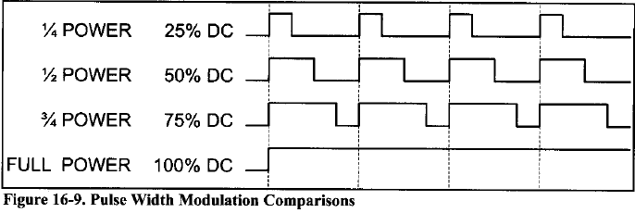

Slide 34
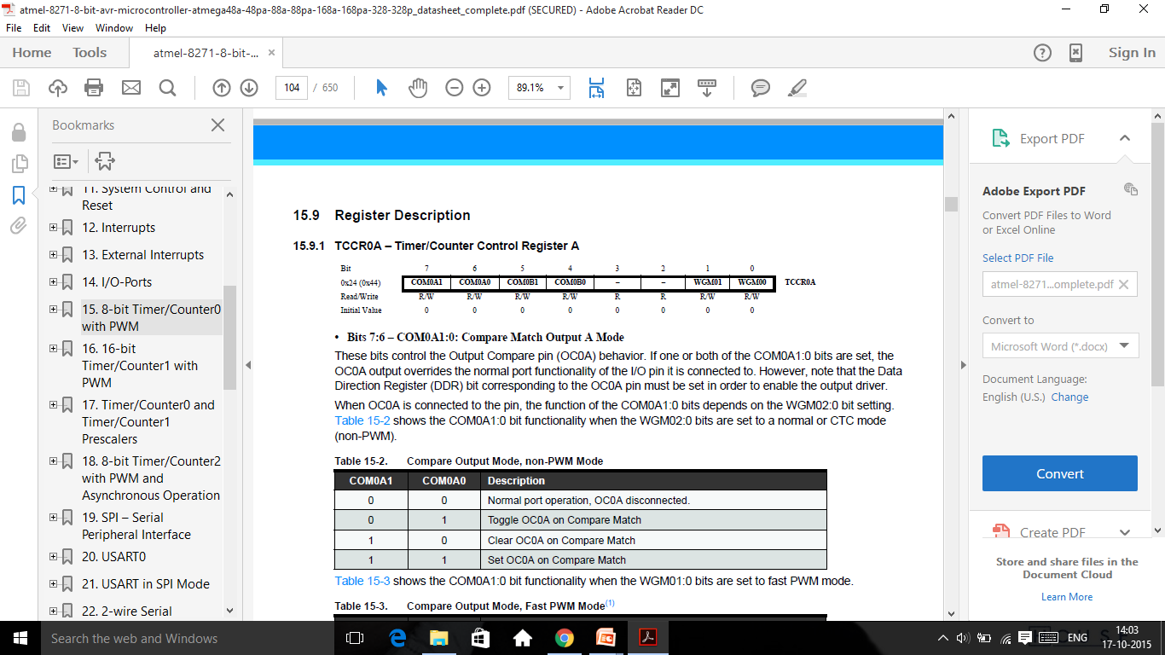
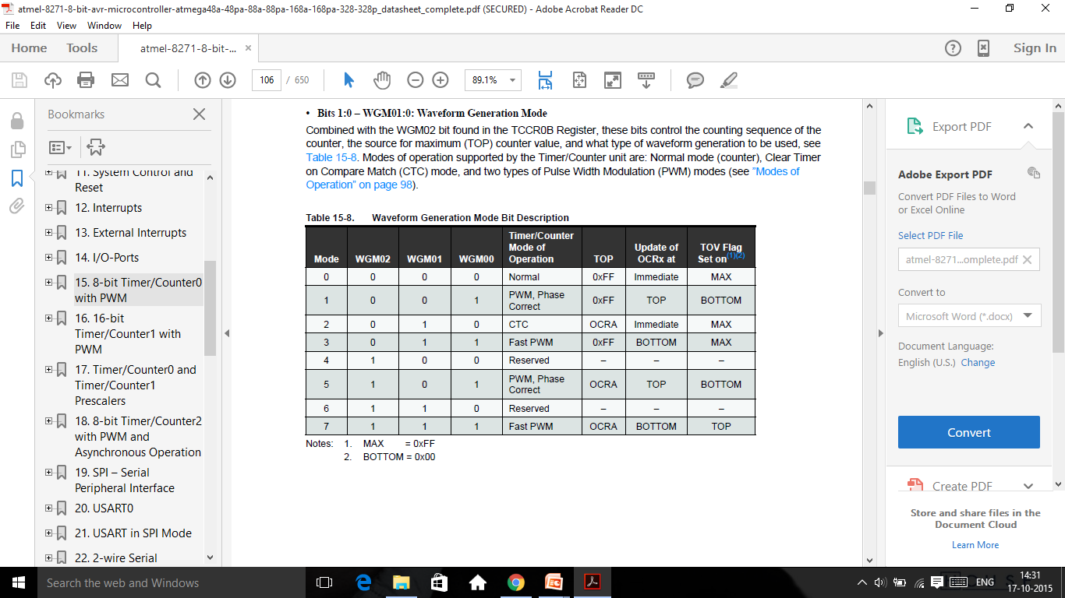
Fast PWM Mode :
Timer functions similar to Normal Mode. TCCR0 bits revisited.

Slide 35
OCR PLAYS A ROLE
I need to know for how long I have to supply 1 and how long 1 have to supply 0.
OCR gives me that reference.
OCR value lies between 0 and TOP value.
1 (HIGH) will be given depending on whether TCNT value is lower than OCR or higher.
TWO MODES:
Non-Inverting mode
Inverting mode

Slide 36
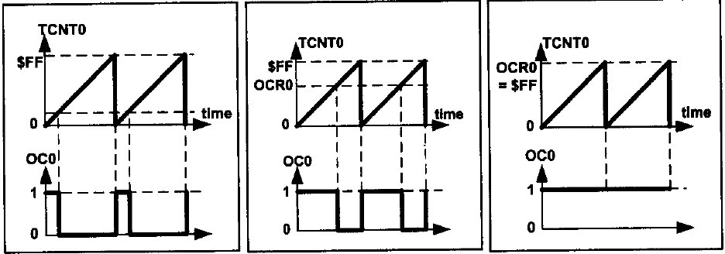
Non-Inverted PWM

Slide 37
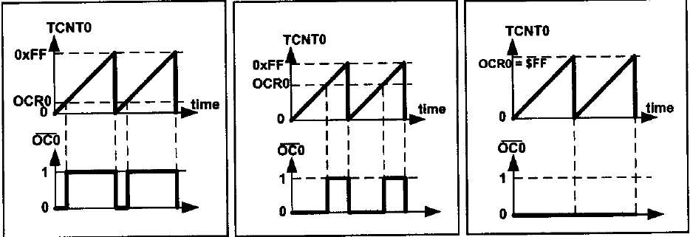
Inverted PWM

Slide 38
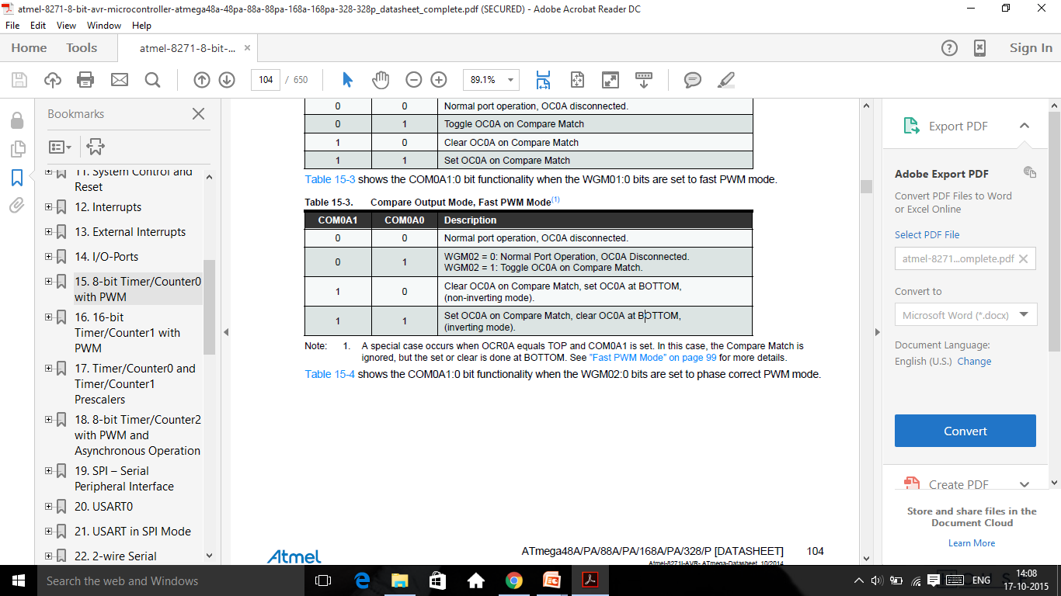
In non-inverting Compare Output mode, the Output Compare (OC0x) is cleared on the compare match between TCNT0 and OCR0x, and set at BOTTOM.
In inverting Compare Output mode, the output is set on compare match and cleared at BOTTOM.
Toggle Mode - In this mode, the output toggles whenever there is a compare match. If the output is high, it becomes low, and vice-versa.

Slide 39


Characteristics Of Generated Wave:
DUTY CYCLE
Non- inverted Mode:
Inverted Mode:

Slide 40
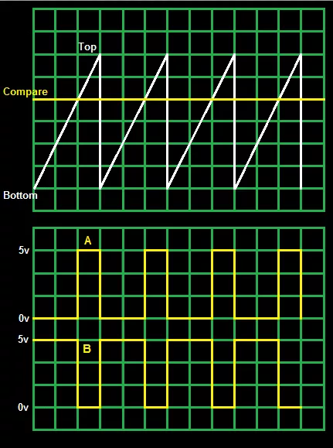

Slide 41
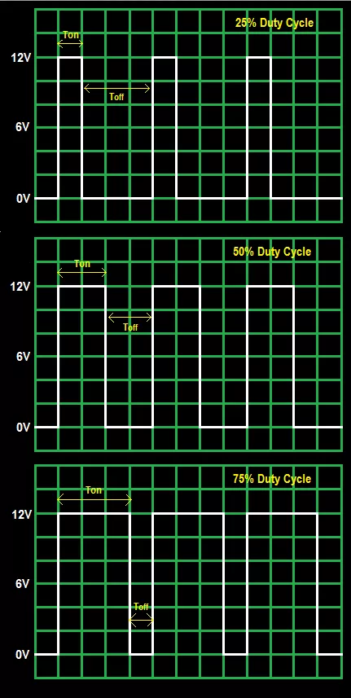
Fig showing pulses with different duty cycle

Slide 42
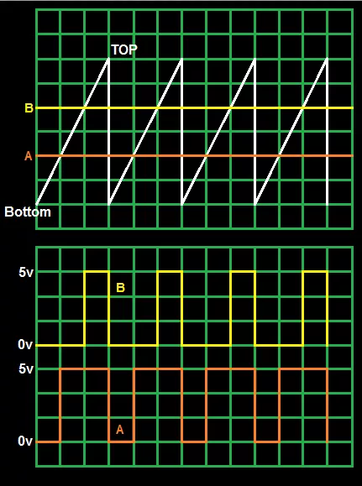
Fast PWM :

Slide 43
Applications of PWM:
Control DC motor’s speed.
Control a Servo motor’s Orientation.

Slide 44
Code and task : Fading an LED
#include<avr/io.h>
#include<util/delay.h>
int main()
{
DDRD|=0b01000000; TCCR0A|=(1<<COM0A1)|(1<<WGM01)|(1<<WGM00);
// non inverter mode and fast pwm
TCCR0B|=(1<<CS00);
//prescaler1
while(1)
{
for(int i=0;i<=255;i++)
{OCR0A=i;
_delay_ms(10);
}
for(int i=255;i>0;i--)
{OCR0A=i;
_delay_ms(10);}
}
}

Slide 45

Interrupts

Slide 46
Let us think of a very common real world situation
You are reading a book , suddenly a courier guy comes and rings the door bell. The bell raises an alert for you , you put a bookmark , go receive the parcel and come back to start reading.
---- Situation 1.
Now , let’s take another situation. You are expecting an important letter delivery but unfortunately your doorbell is not working. So you have to go and check the letter box after say every half n hour.
--- Situation 2.

Slide 47

So we saw two different situations in the last slide. If you think from an MCU’s point of view the first case is what we called Interrupting , i.e. raising an alarm while the second stage is called Polling – waiting for a particular event to happen in order to move to next event.
Now that you know two terms – interrupt & polling and their difference , let us see why do we need interrupts ?

Slide 48
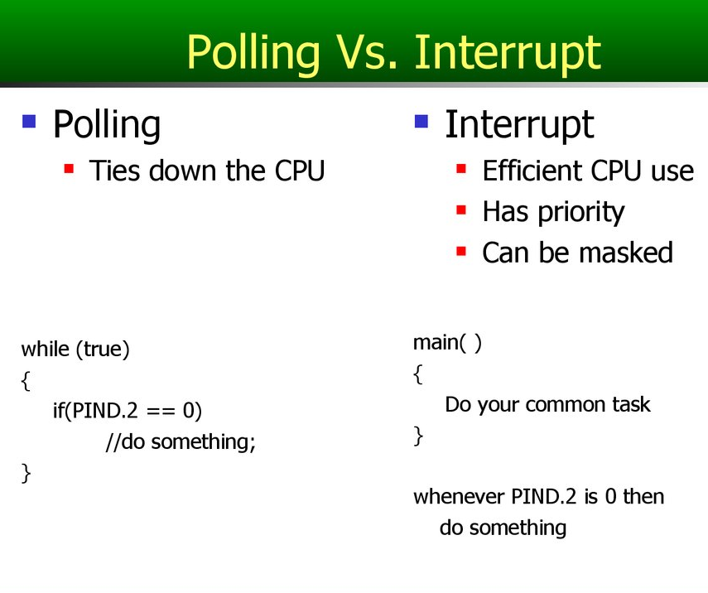
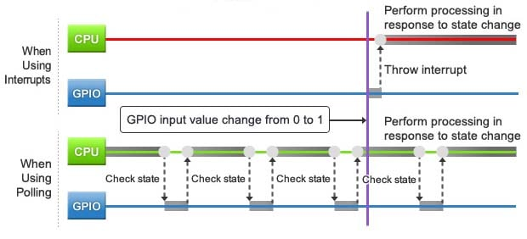

ANS:

Slide 49

Interrupts in Arduino:
In Arduino , there are many types of interrupts :
External Interrupt
Pin change interrupt
Interrupts in Timer
Interrupts in ADC
Interrupts in USART
With so many interrupts , if all fires at the same time , per say , how does the microcontroller prioritize ?

Slide 50
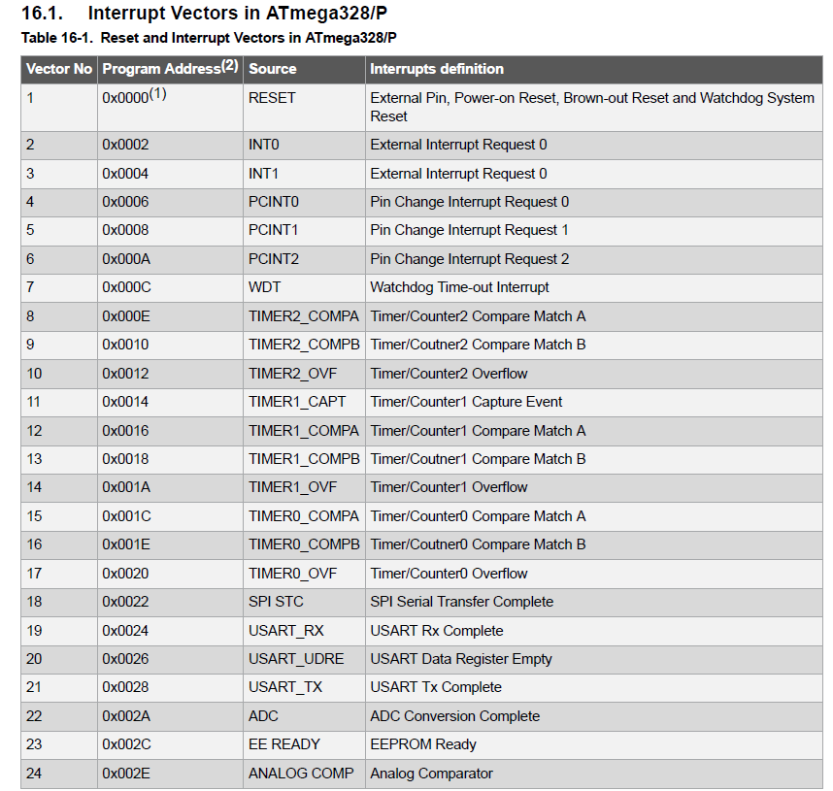
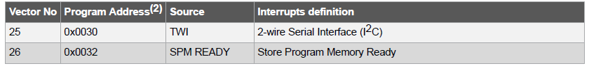
Priority order for interrupts

Slide 51
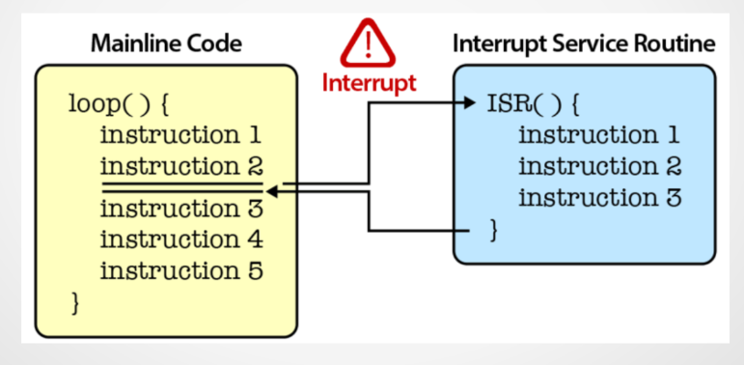
Interrupt Service Routine
The part of the code which contains the interrupt command to be executed.

Slide 52
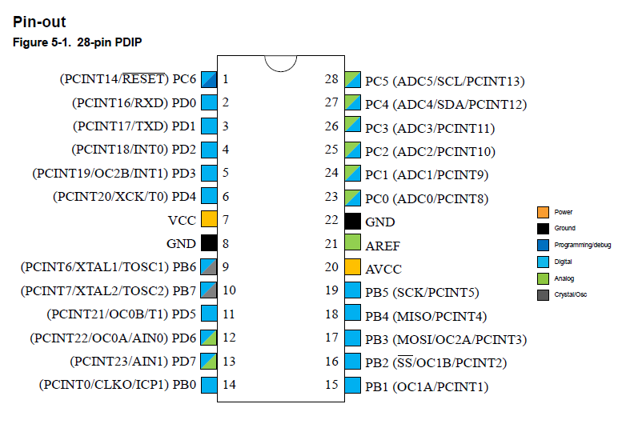
Interrupt Pins in Arduino:

Slide 53
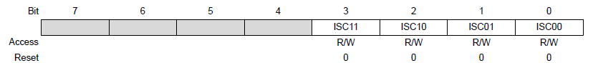
External Interrupts :
In Arduino , External Interrupts can be used via any of the following set of pins
INT0 , INT1
PCINT pins( 23 pins )
To control INT1 , INT 0 pins , we have three registers : EICRA , EIMSK & EIFR.
EICRA :

Slide 54
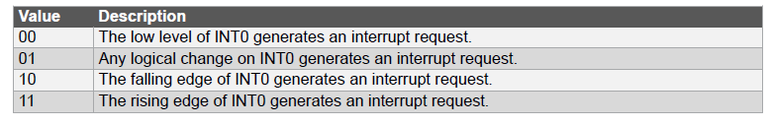
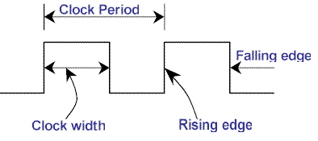
External Interrupts (Contd..):
Function of Interrupt Sense Control(ISC) bits

Slide 55

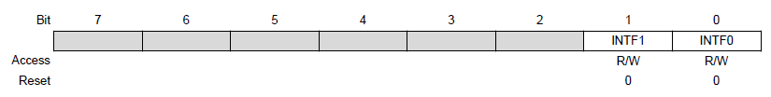
External Interrupts (Contd..):
EIMSK:
EIFR:
We need to write 1 to the INT1 and INT0 bits in EIMSK to enable the corresponding interrupts.
In EIFR , there are two bits INTF1 and INTF0 which get set to 1 whenever corresponding interrupt is fired, and get automatically set to 0 once that particular ISR is over.

Slide 56
How to code the interrupts ?
#include<avr/io.h>
int main()
{
SREG |=1<<I; //enables the global interrupt
EIMSK|=1<<INT0|1<<INT1; //enabling the interrupts
EICRA |=1<<ISC00|1<<ISC10; //setting the input //sense to any logical change
while(1)
{
/* body of the code*/
}
}
ISR(INT0_vect)
{
/*code*/
}

Slide 57
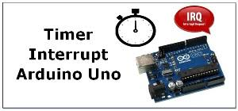
Internal Interrupts :
Here we will see only Timer Interrupts.
Timer has 2 interrupt associated with it
Timer overflow Interrupt
Compare Match Interrupt

Slide 58
Timer Overflow Interrupt :
Whenever Timer Counter overflows Timer overflow flag bit goes high.
If the Interrupt is enabled then the corresponding interrupt will be fired
Once the routine is completed the flag bit automatically goes to low.
The I bit in SREG register should be high to call global interrupts.
To do that, include #include<avr/interrupt.h> and in the main() just call once sei() function. ( Set Interrupt Enable) .
Or else you can do this way also SREG |=1<<I;

Slide 59
Toggle Led using Interrupt :
#include<avr/io.h>
#include<avr/interrupt.h>
volatile int k = 0;
ISR(TIMER0_OVF_vect) {
++k;
}
int main()
{
sei();
DDRB = 0x00;
TCCR0A = 0x00;
TCCR0B= (1<<CS02)|(1<<CS00);
while(1)
{
if(k>=200) {
PORTB^=0xFF;
k=0;
}
}
return 0;
}

Slide 60
Thank You

